Slide 1
Superstore Sales Analysis Project.

Slide 2
Objective of the project:
Superstore Sales Analysis Project aims to explore and analyse the orders given by customers. The Superstore Data Analysis Project focuses on extracting insights from a retail superstore dataset. The dataset contains information about sales, customers, products, and orders from a fictional retail superstore.
By analyzing this data, we aim to uncover trends, patterns, and insights that can be used to improve business operations and decision-making.

Slide 3
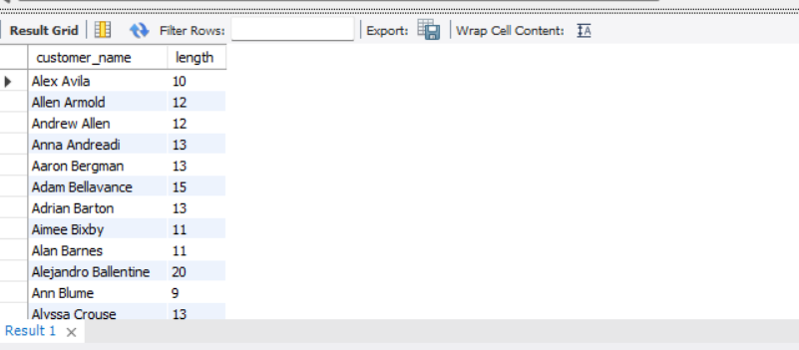
How many characters are there in the customer_name field of the customer table? select customer_name, length(customer_name) as length from customer;
Result:

Slide 4
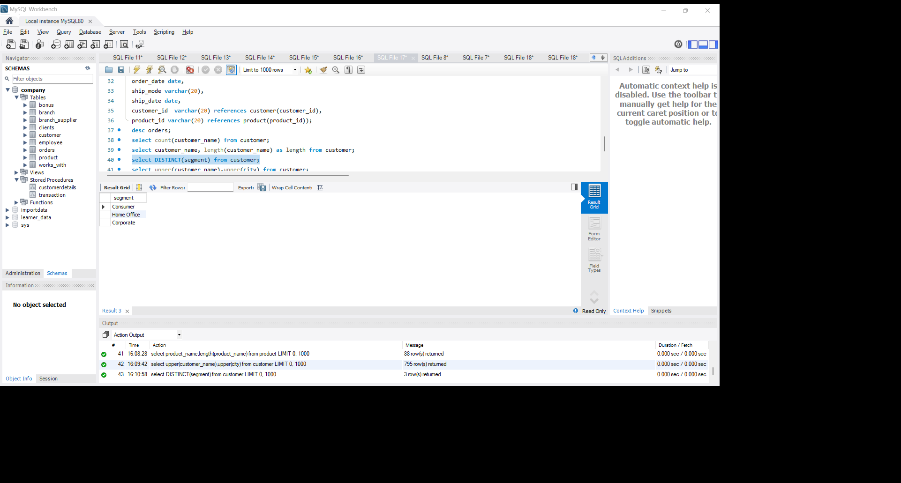
Can you list all unique segments present in the customer table? select DISTINCT(segment) from customer;
Result:

Slide 5
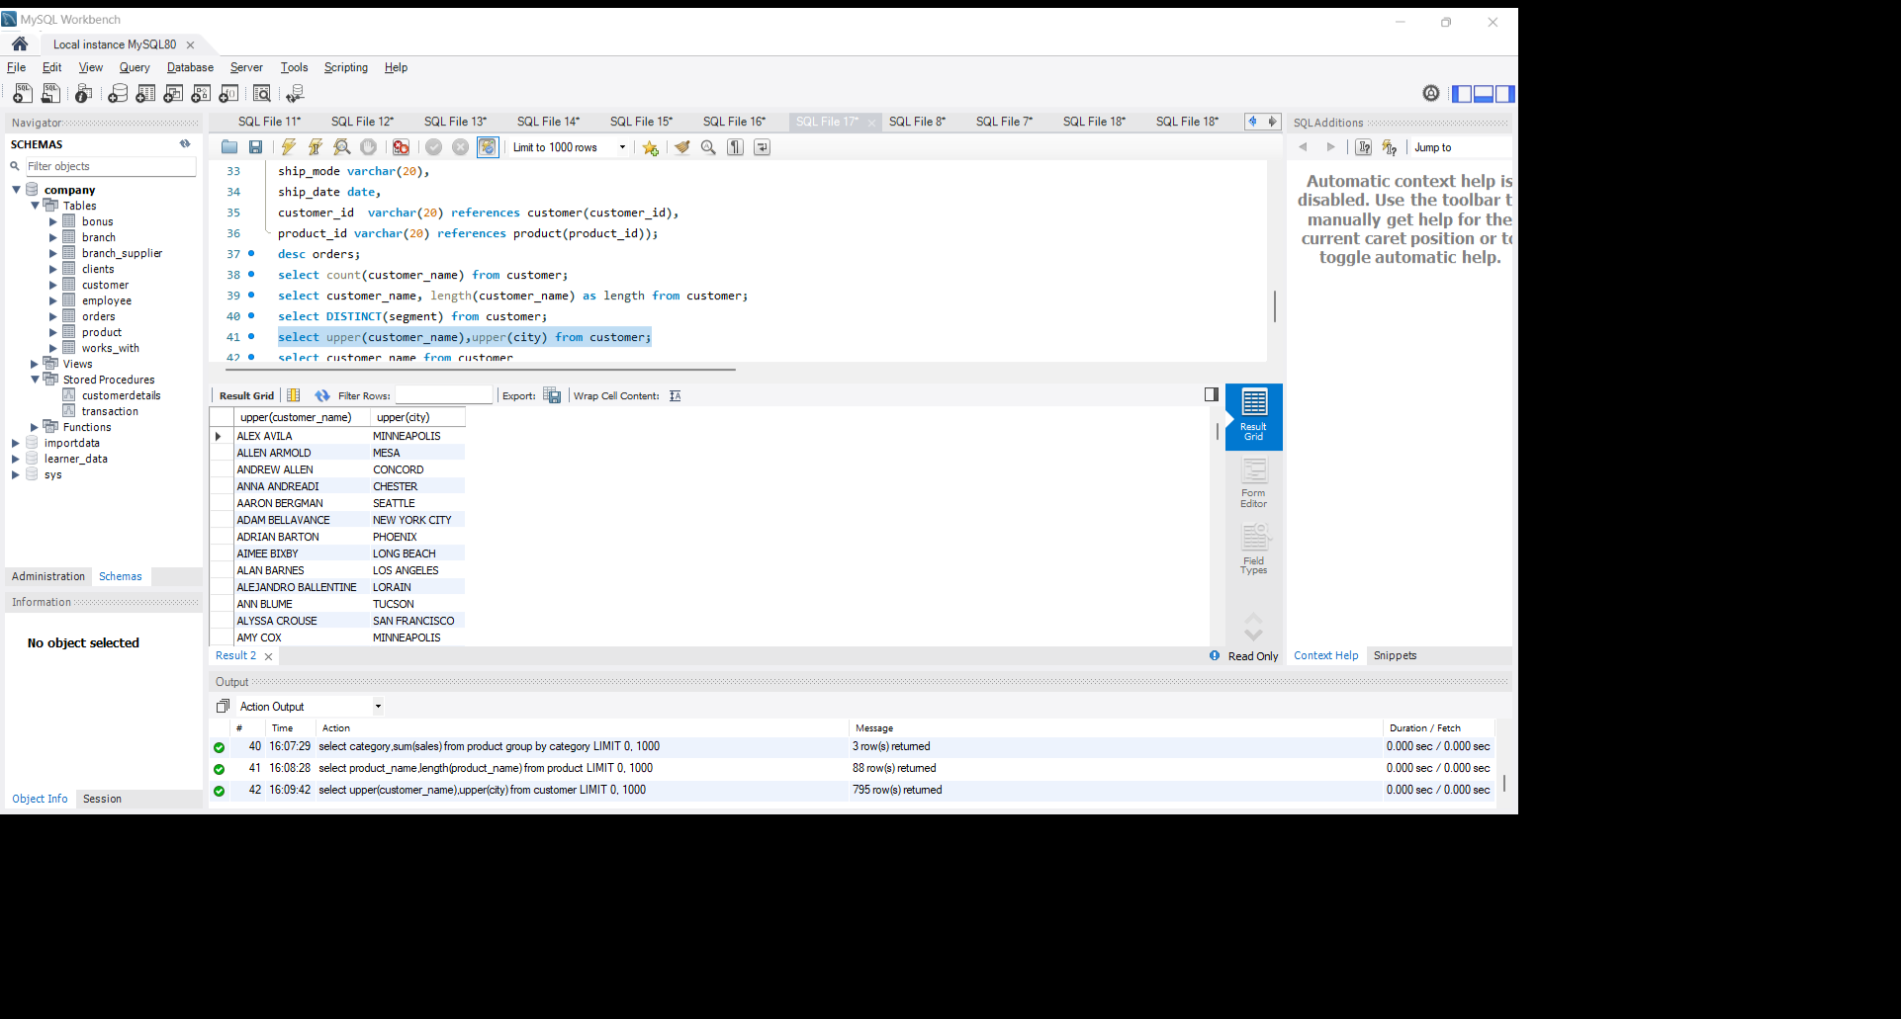
Show the customer_name and city in uppercase for all customers? select upper(customer_name),upper(city) from customer;
Result:

Slide 6
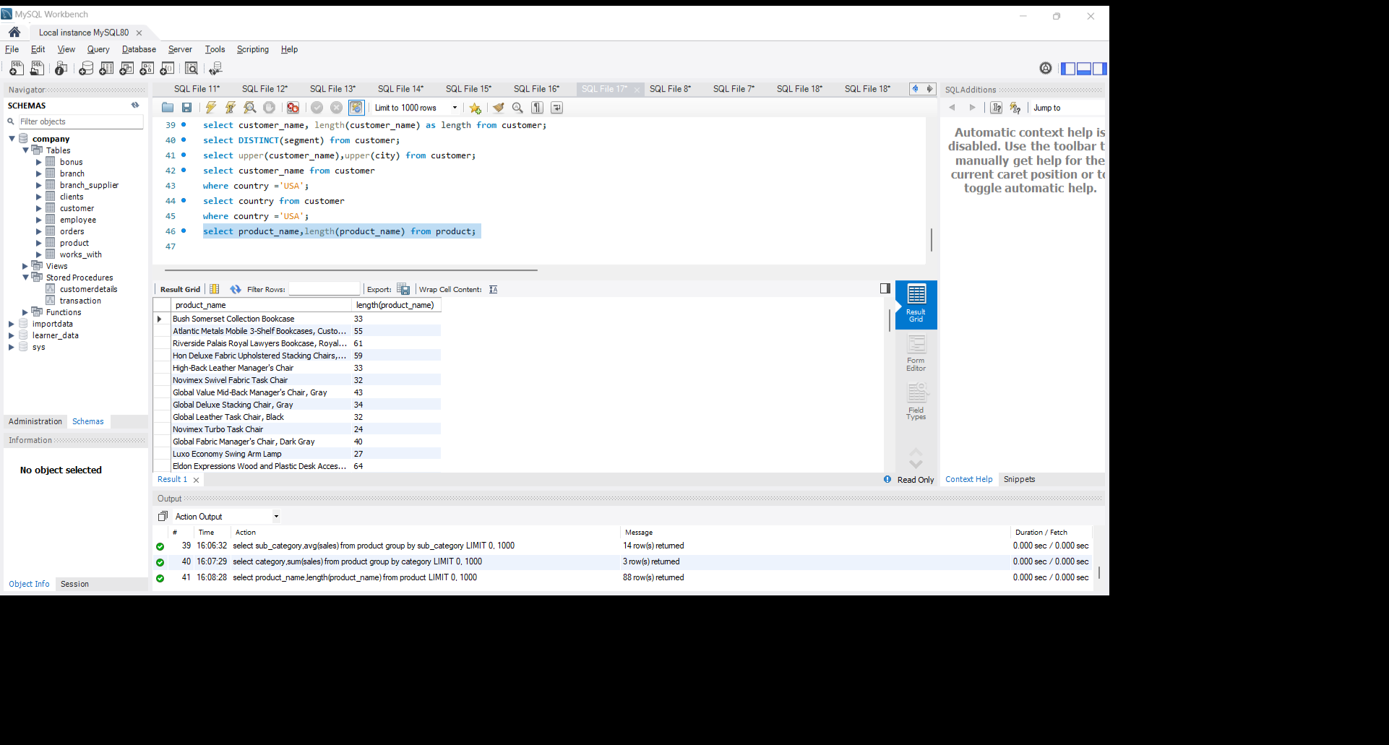
Display the length of each product_name in the product table.? select product_name,length(product_name) from product;
Result:

Slide 7
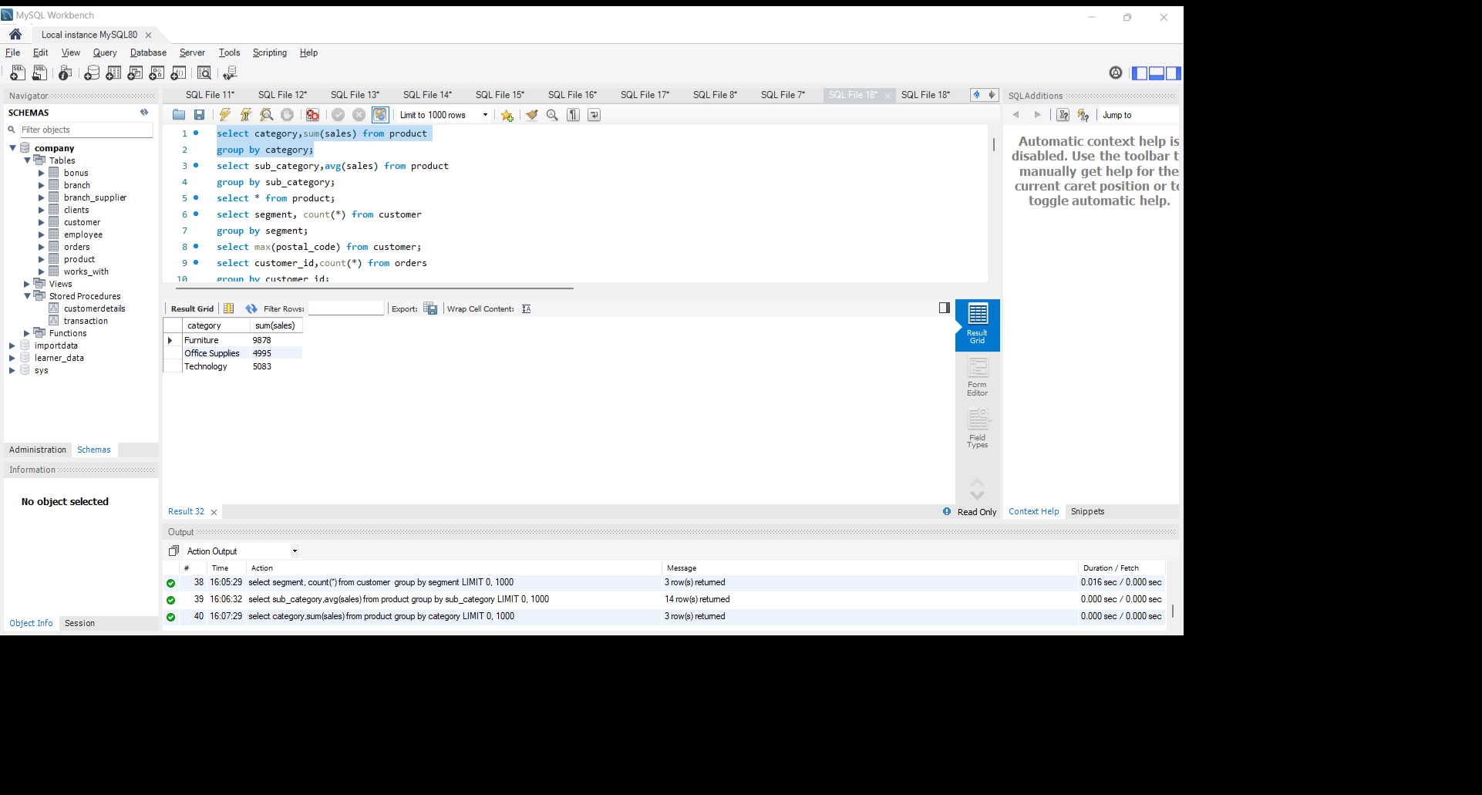
What is the total sales revenue for each category in the product table? select category,sum(sales) from product group by category;
Result:

Slide 8
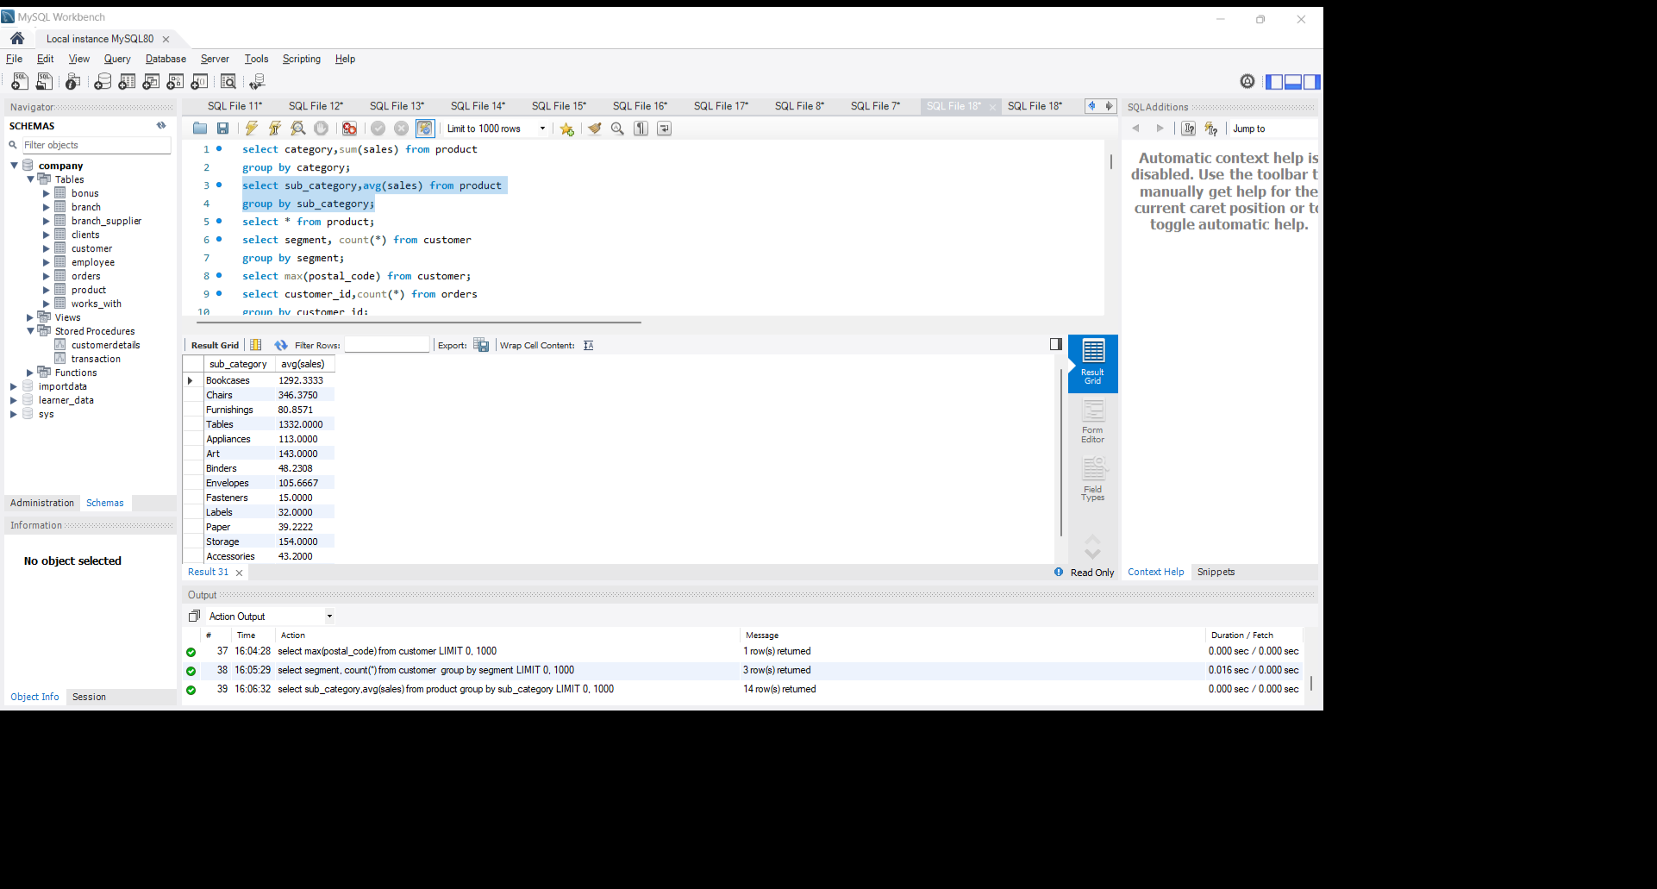
Calculate the average sales per product in the product table.? select sub_category,avg(sales) from product group by sub_category;
Result:

Slide 9
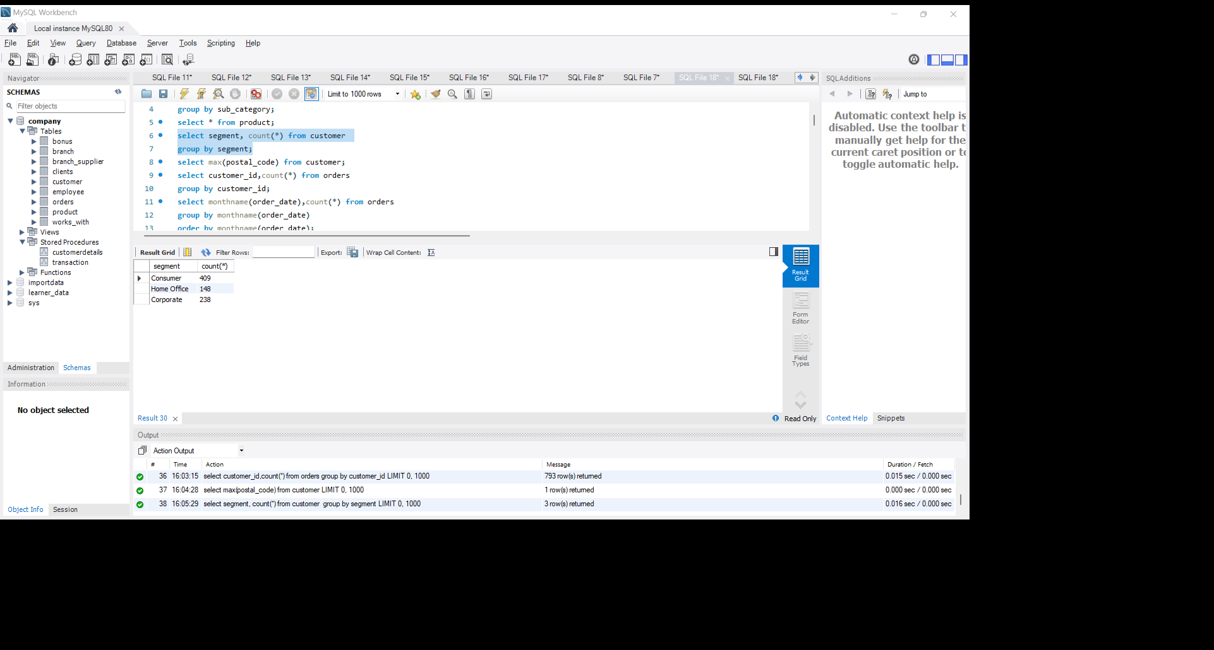
How many customers are there in each segment? select segment, count(*) from customer group by segment;
Result:

Slide 10
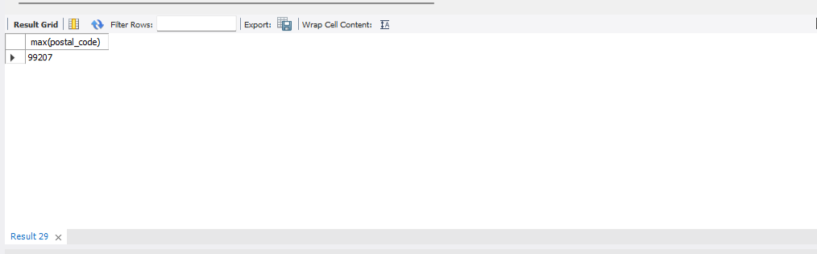
Find the maximum postal code in the customer table.? select max(postal_code) from customer;
Result:

Slide 11
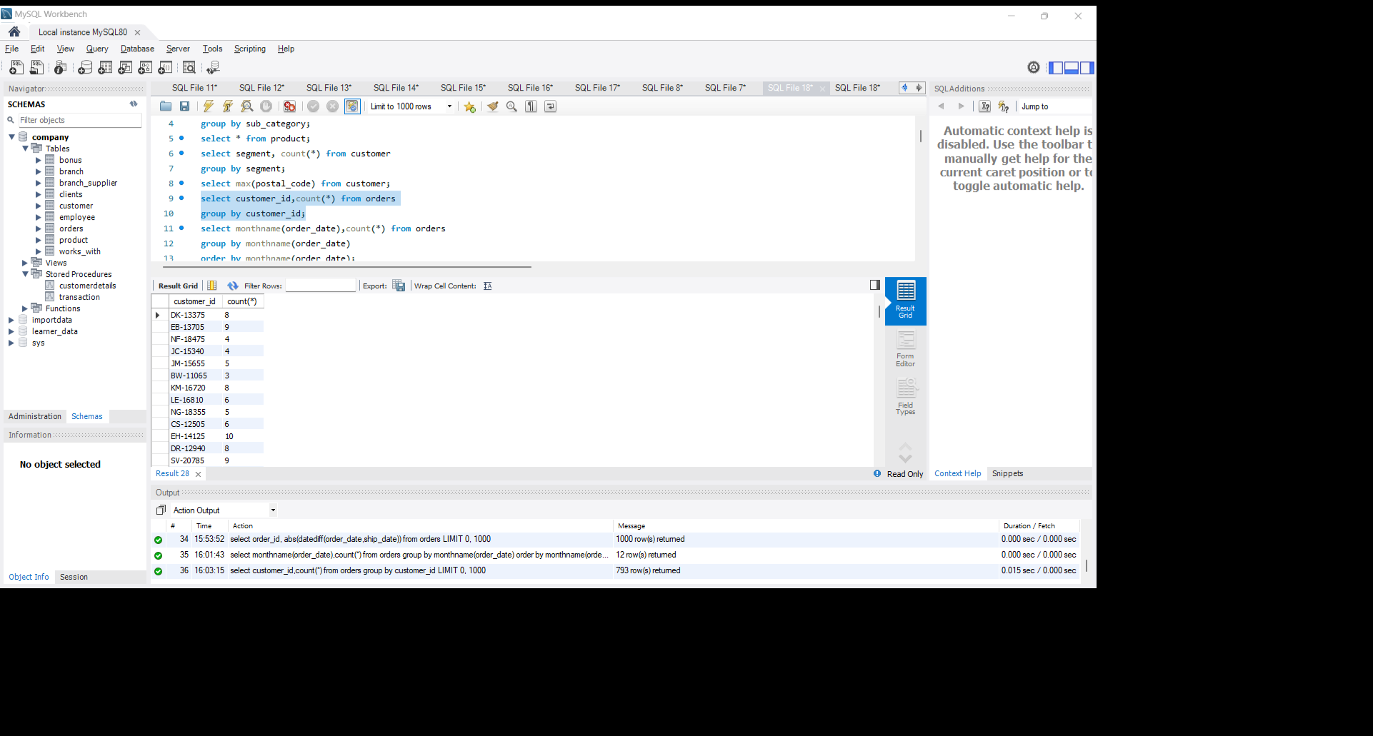
What is the total number of orders placed by each customer? select customer_id,count(*) from orders group by customer_id;
Result:

Slide 12
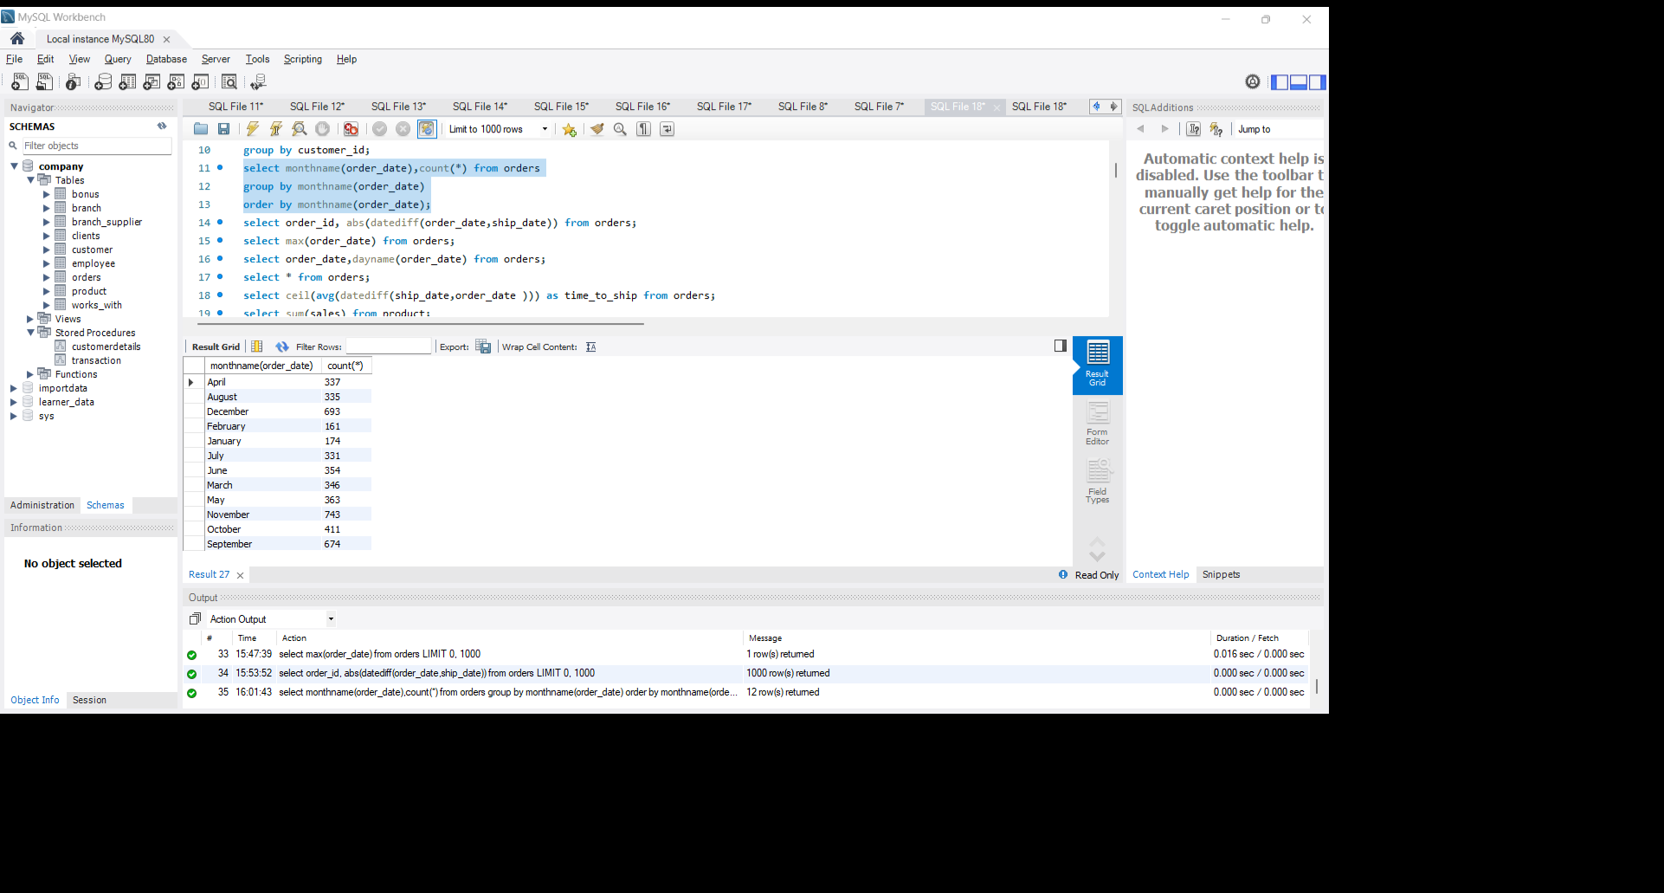
How many orders were placed in each month of the year? select monthname(order_date),count(*) from orders group by monthname(order_date) order by monthname(order_date);
Result:

Slide 13
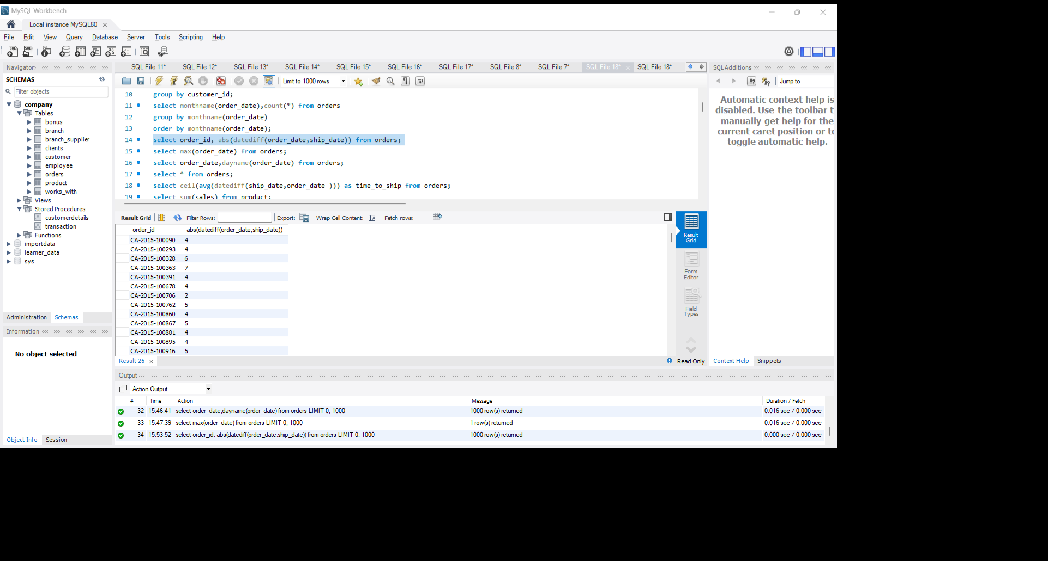
Calculate the difference between order_date and ship_date for each order.? select order_id, abs(datediff(order_date,ship_date)) from orders;
Result:

Slide 14
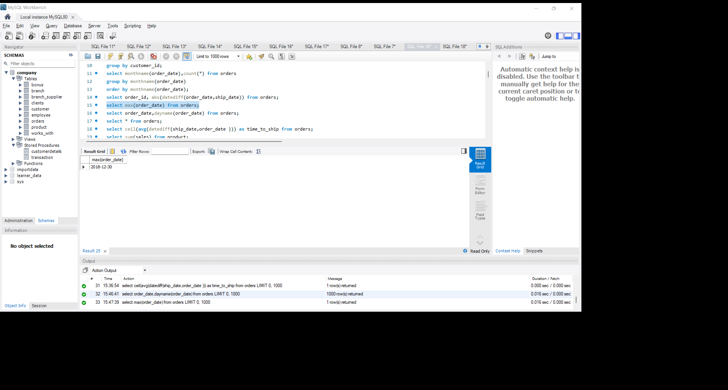
Find the latest order date.? select max(order_date) from orders;
Result:

Slide 15
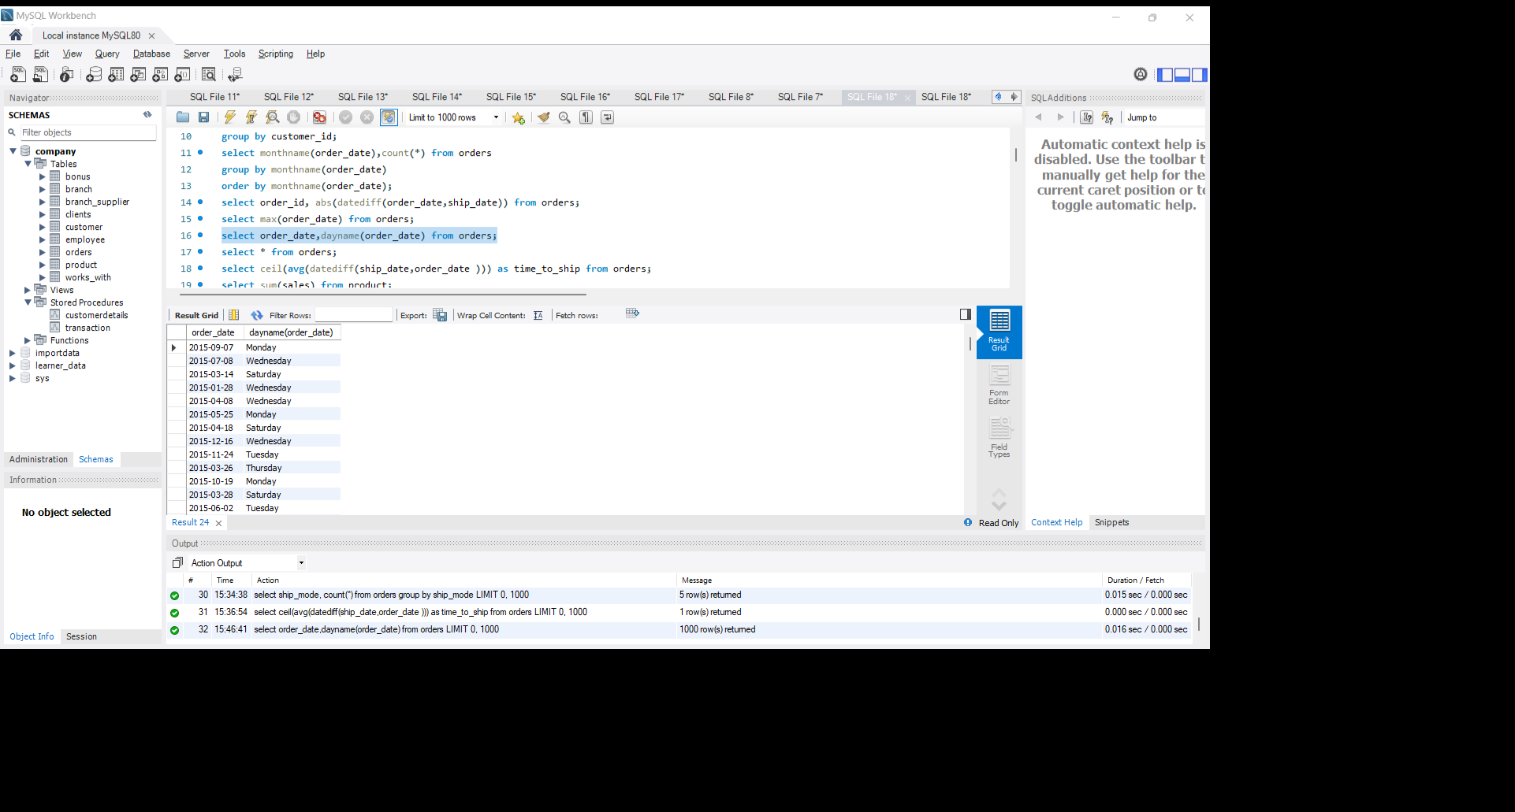
Determine the day of the week for each order_date.? select order_date,dayname(order_date) from orders;
Result:

Slide 16
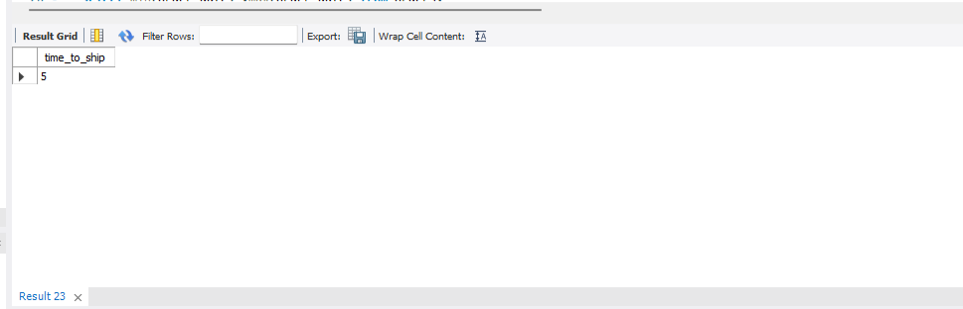
Calculate the average time taken to ship orders.? select ceil(avg(abs(datediff(ship_date,order_date )))) as time_to_ship from orders;
Result:

Slide 17
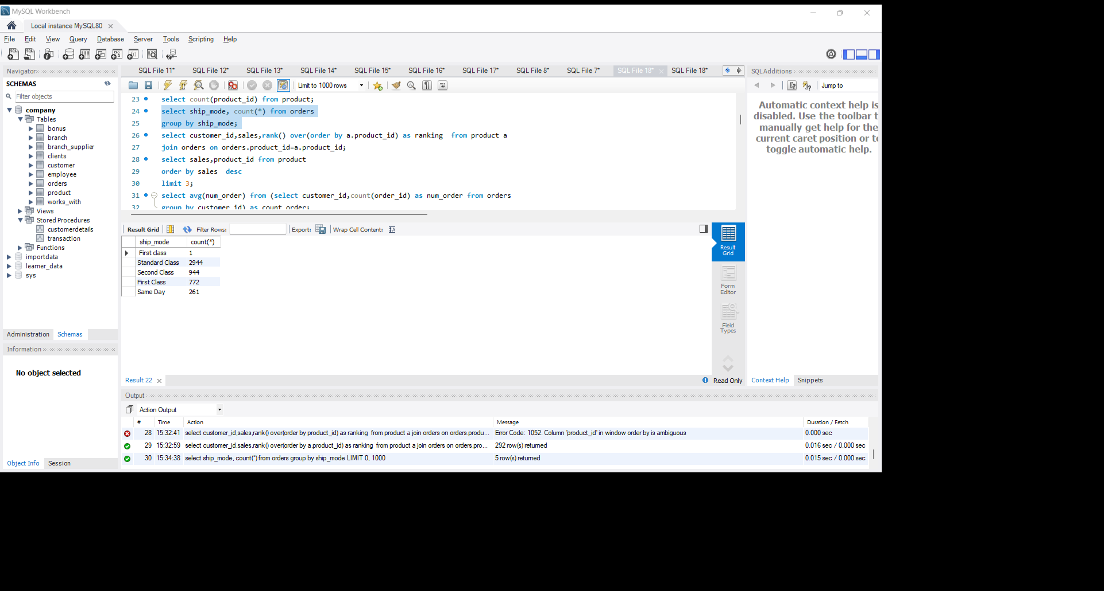
How many orders were placed using each ship mode? select ship_mode, count(*) from orders group by ship_mode;
Result:

Slide 18
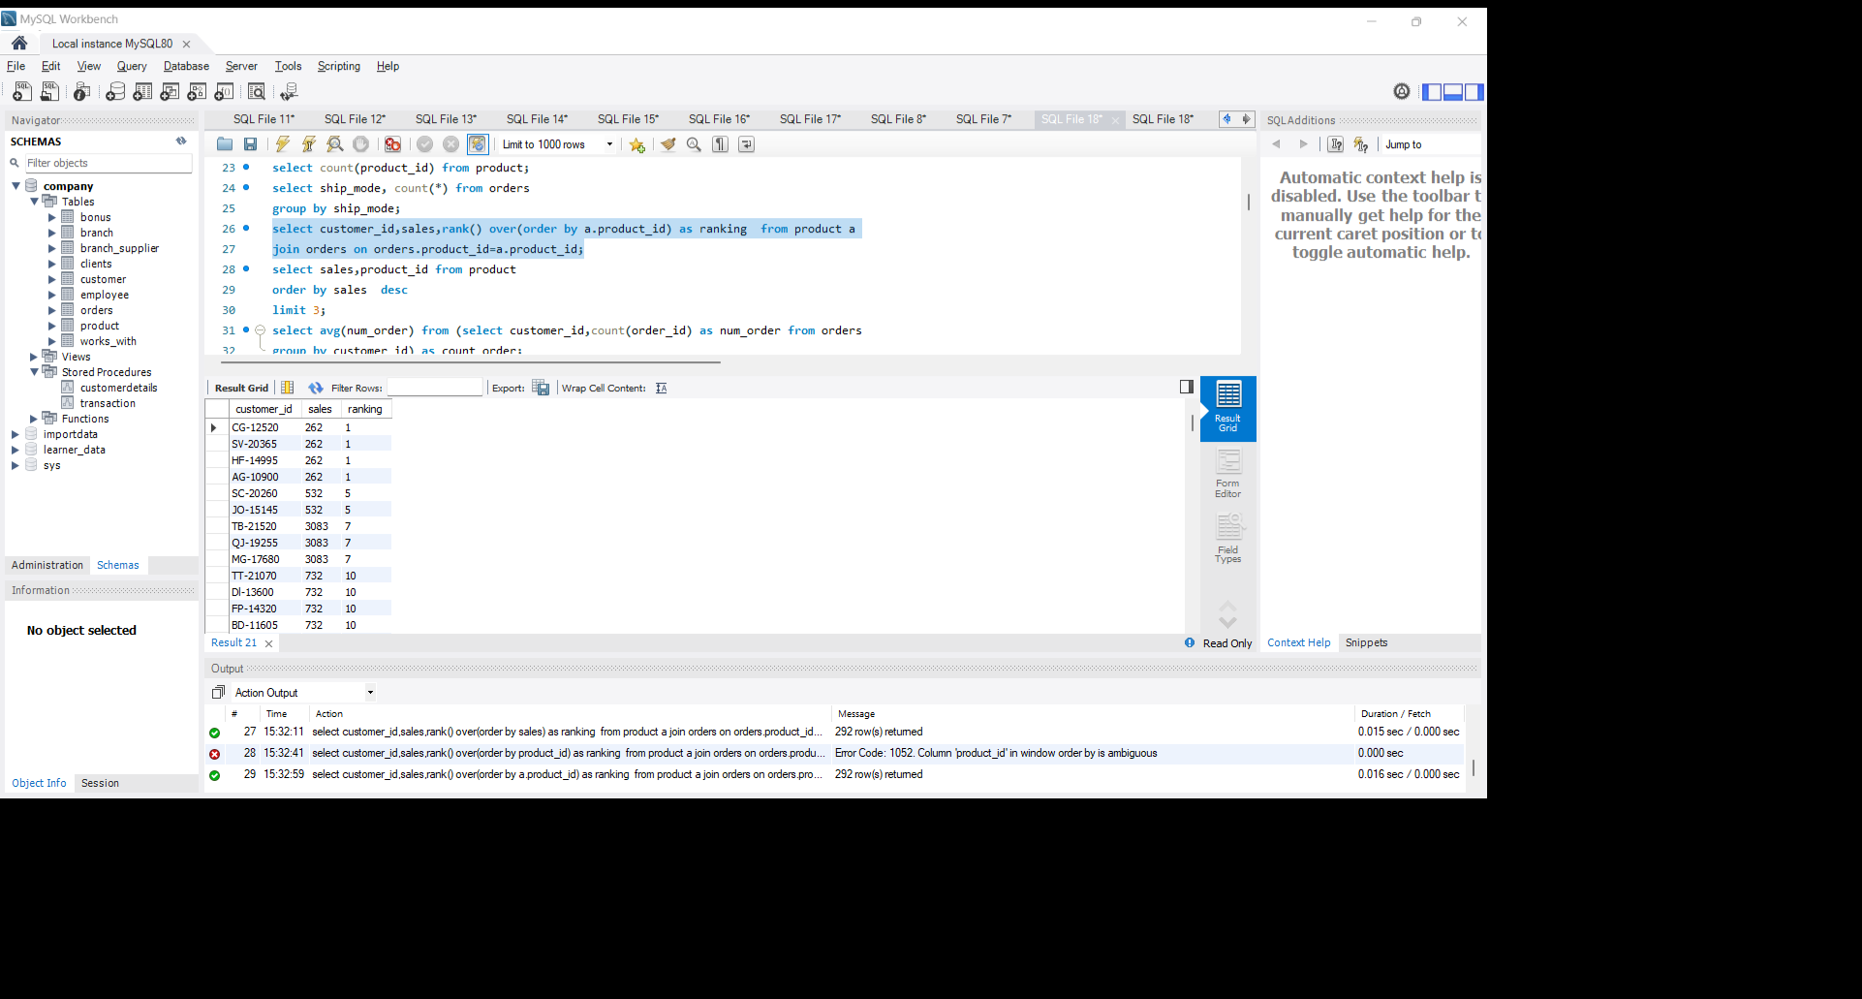
Rank customers based on their total sales revenue.? select customer_id,sales,rank() over(order by a.product_id) as ranking from product a join orders on orders.product_id=a.product_id;
Result:

Slide 19
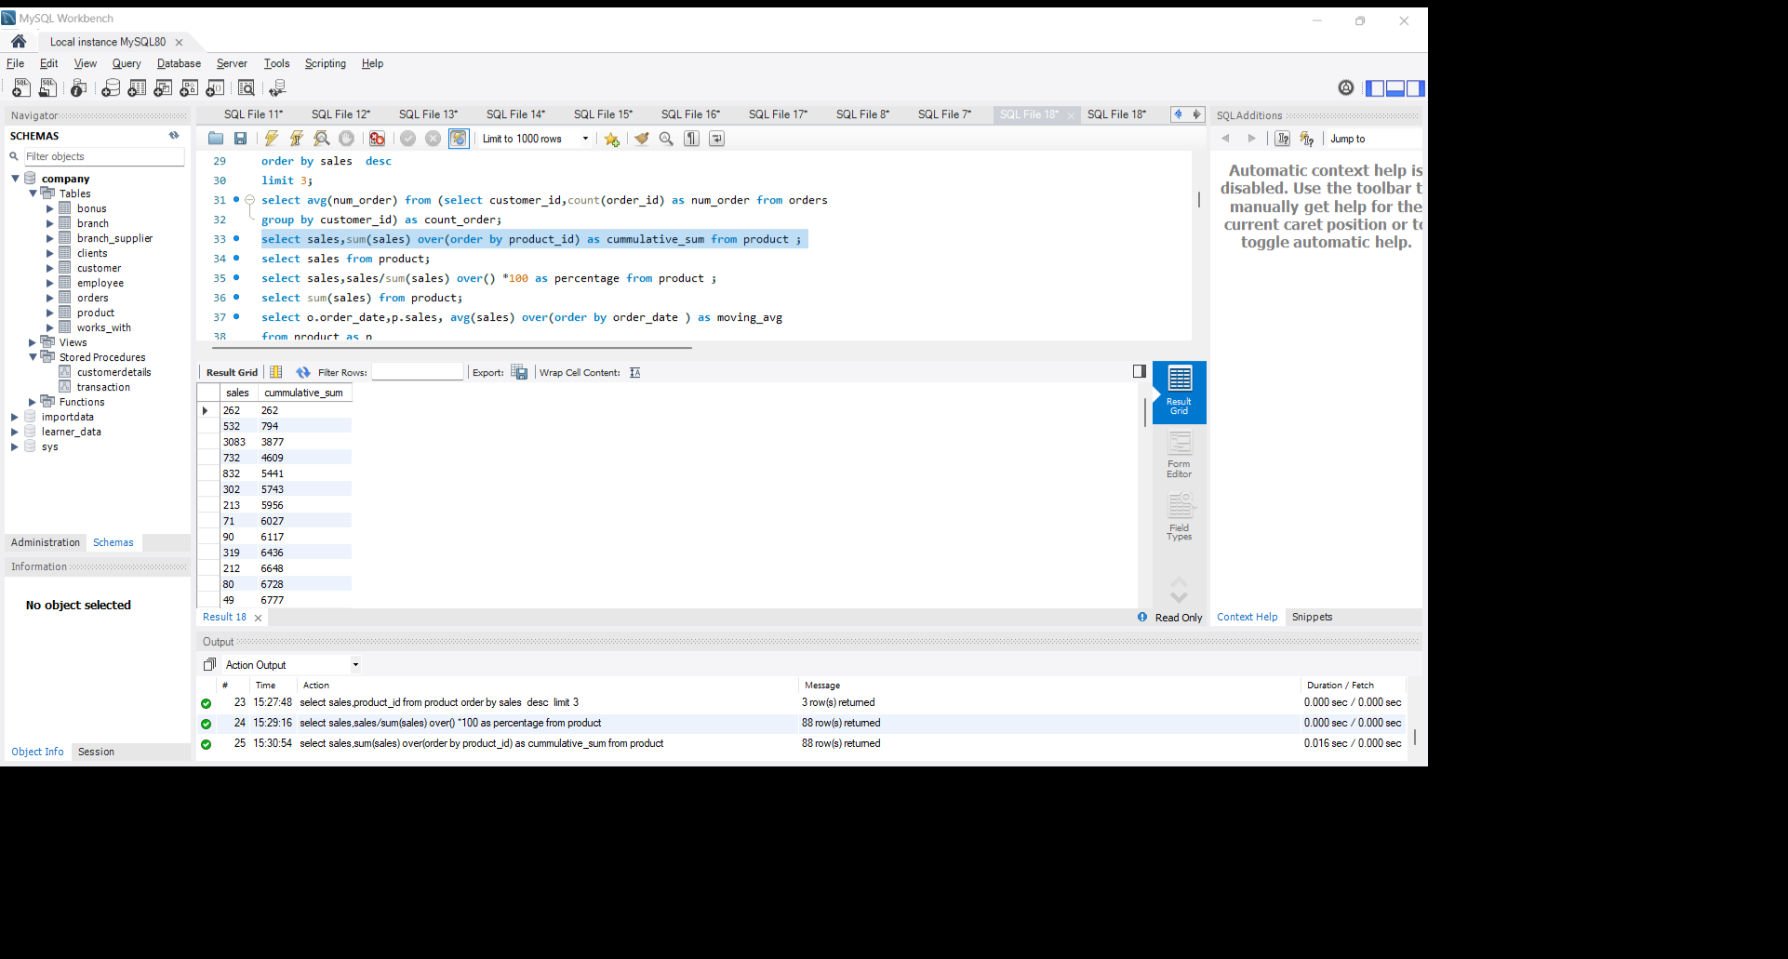
Calculate the cumulative sum of sales for each product.? select sales,sum(sales) over(order by product_id) as cummulative_sum from product ;
Result:

Slide 20
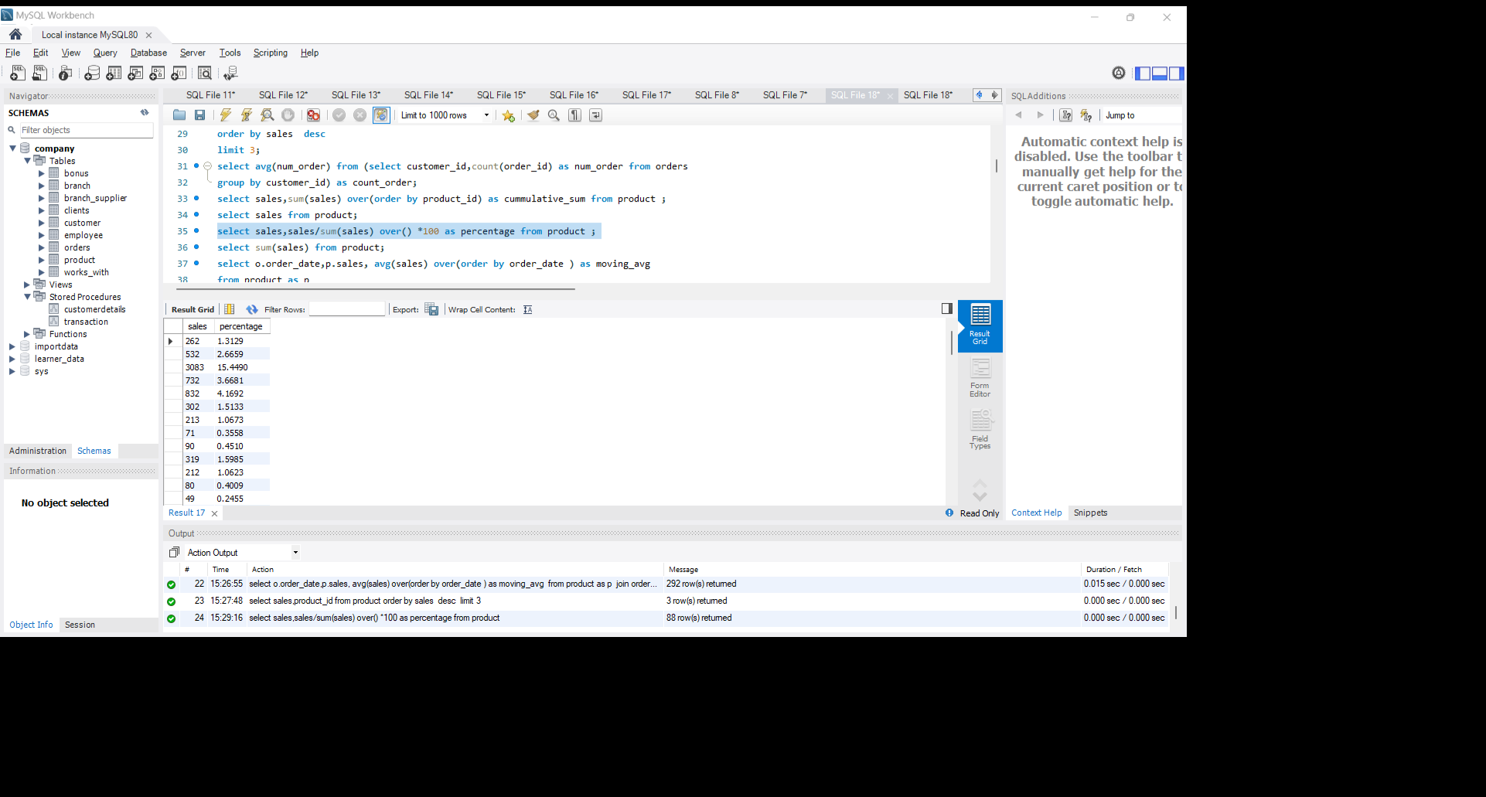
Determine the percentage of total sales each product sales contribute? select sales,sales/sum(sales) over() *100 as percentage from product ;
Result:

Slide 21
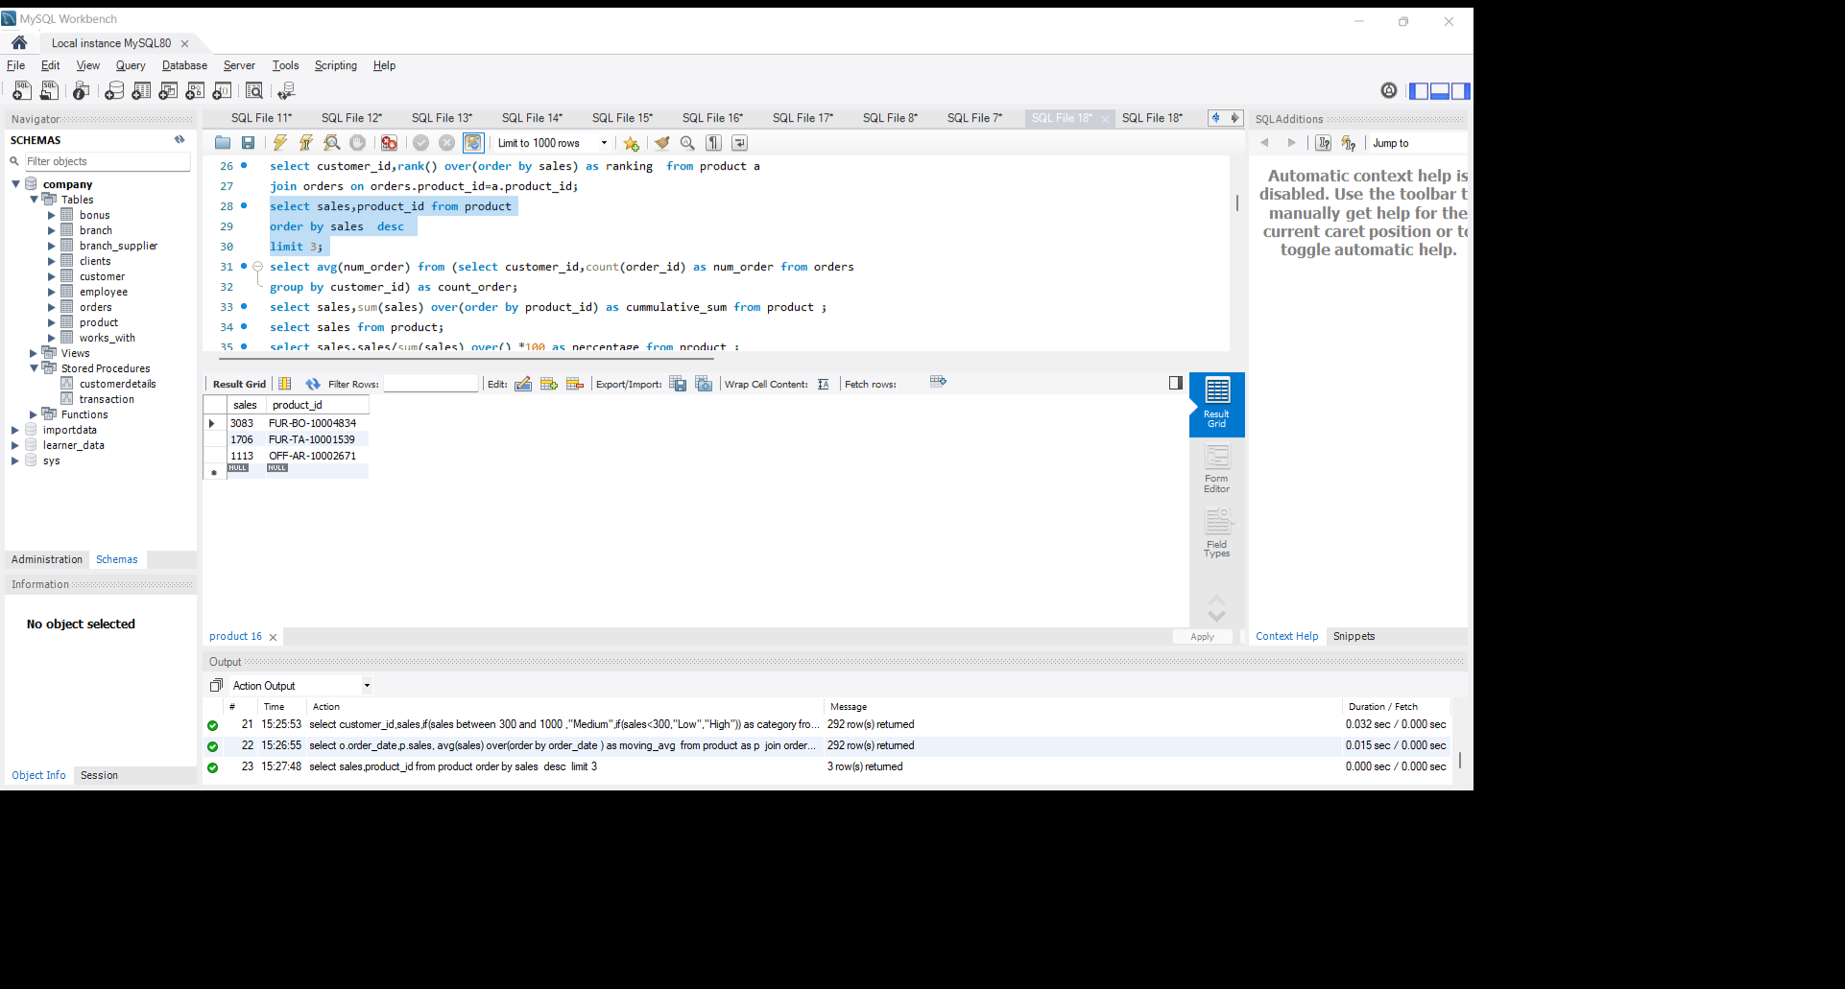
Find the top 3 products in each category based on sales.? select sales,product_id from product order by sales desc limit 3;
Result:

Slide 22
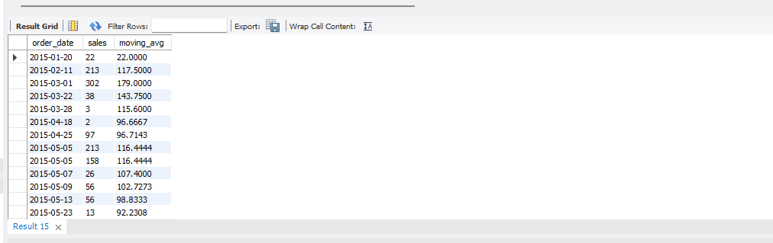
Calculate the moving average of sales over a specific time period.? select o.order_date,p.sales, avg(sales) over(order by order_date ) as moving_avg from product as p join orders as o on o.product_id=p.product_id;
Result:

Slide 23
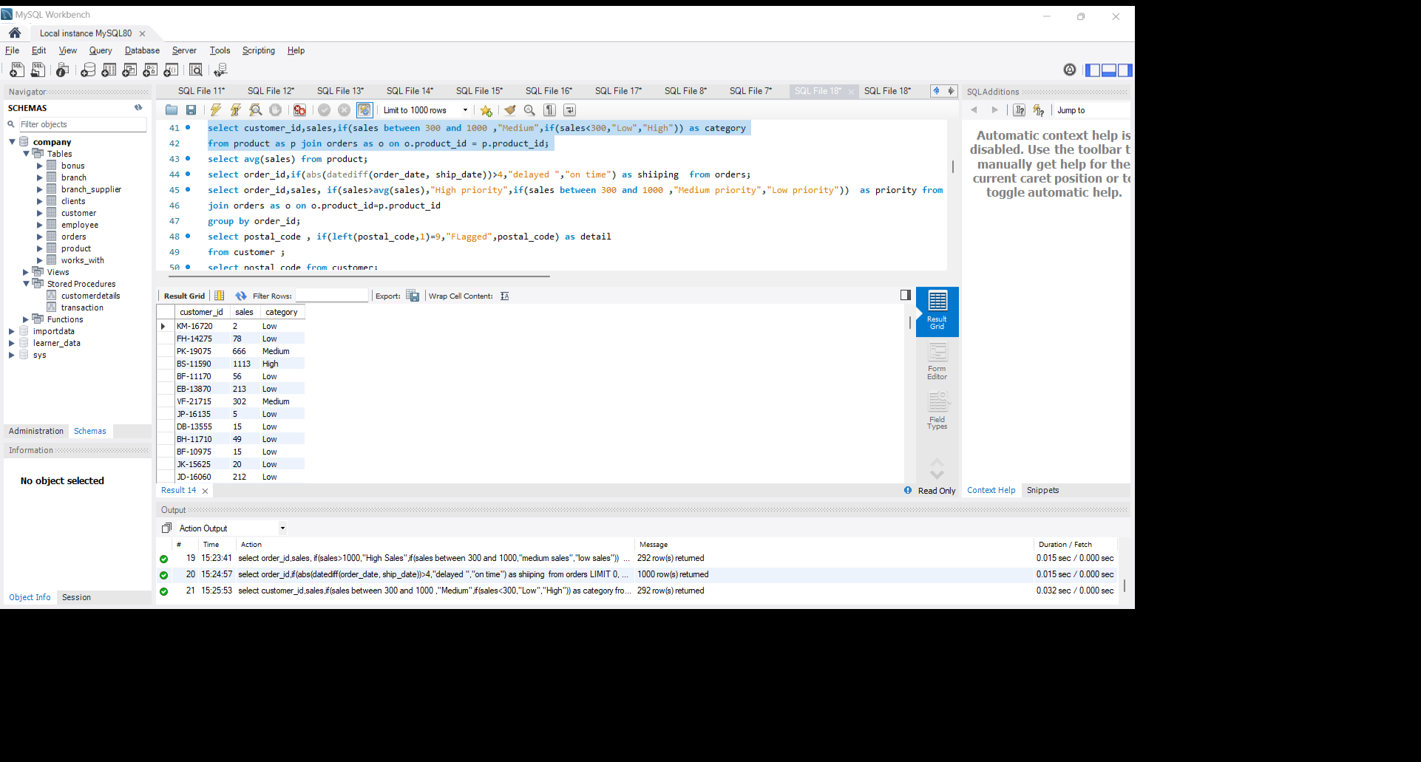
classify customers into 'High', 'Medium', or 'Low' based on their total sales.? select customer_id,sales,if(sales between 300 and 1000 ,"Medium",if(sales<300,"Low","High")) as category from product as p join orders as o on o.product_id = p.product_id;
Result:

Slide 24
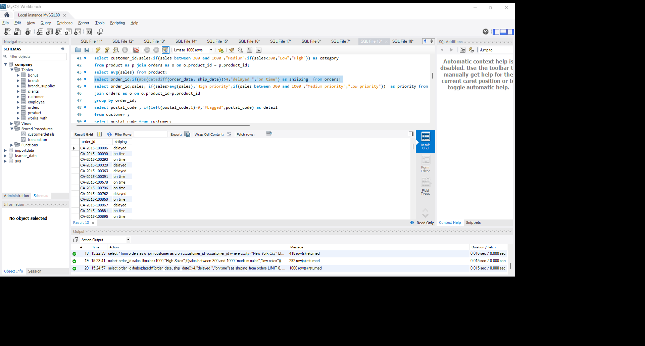
Identify orders that were shipped on time or delayed.? select order_id,if(abs(datediff(order_date, ship_date))>4,"delayed ","on time") as shiping from orders;
Result:

Slide 25
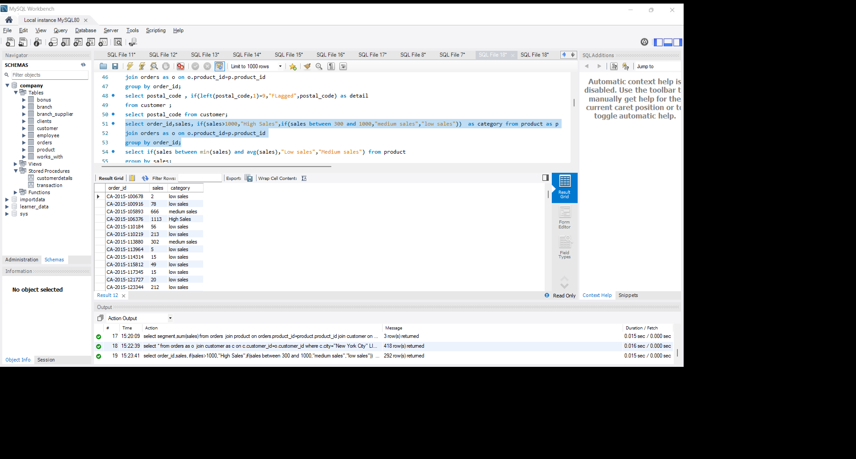
Classify products into different categories based on their sales.? select order_id,sales, if(sales>1000,"High Sales",if(sales between 300 and 1000,"medium sales","low sales")) as category from product as p join orders as o on o.product_id=p.product_id group by order_id;
Result:

Slide 26
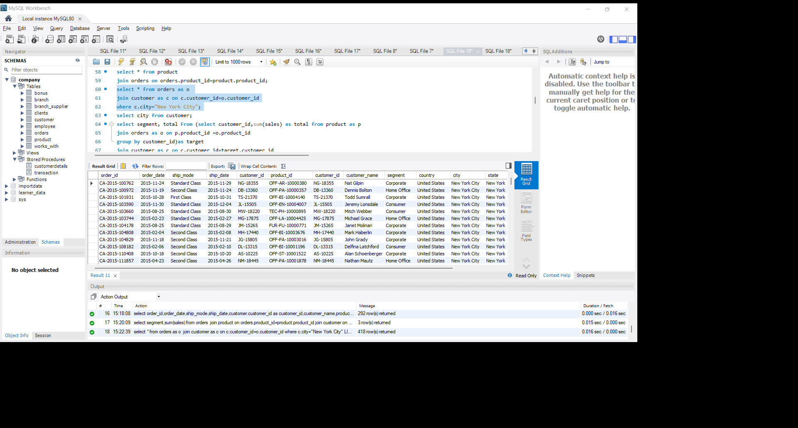
Find orders placed by customers from a specific city.? select * from orders as o join customer as c on c.customer_id=o.customer_id where c.city="New York City";
Result:

Slide 27
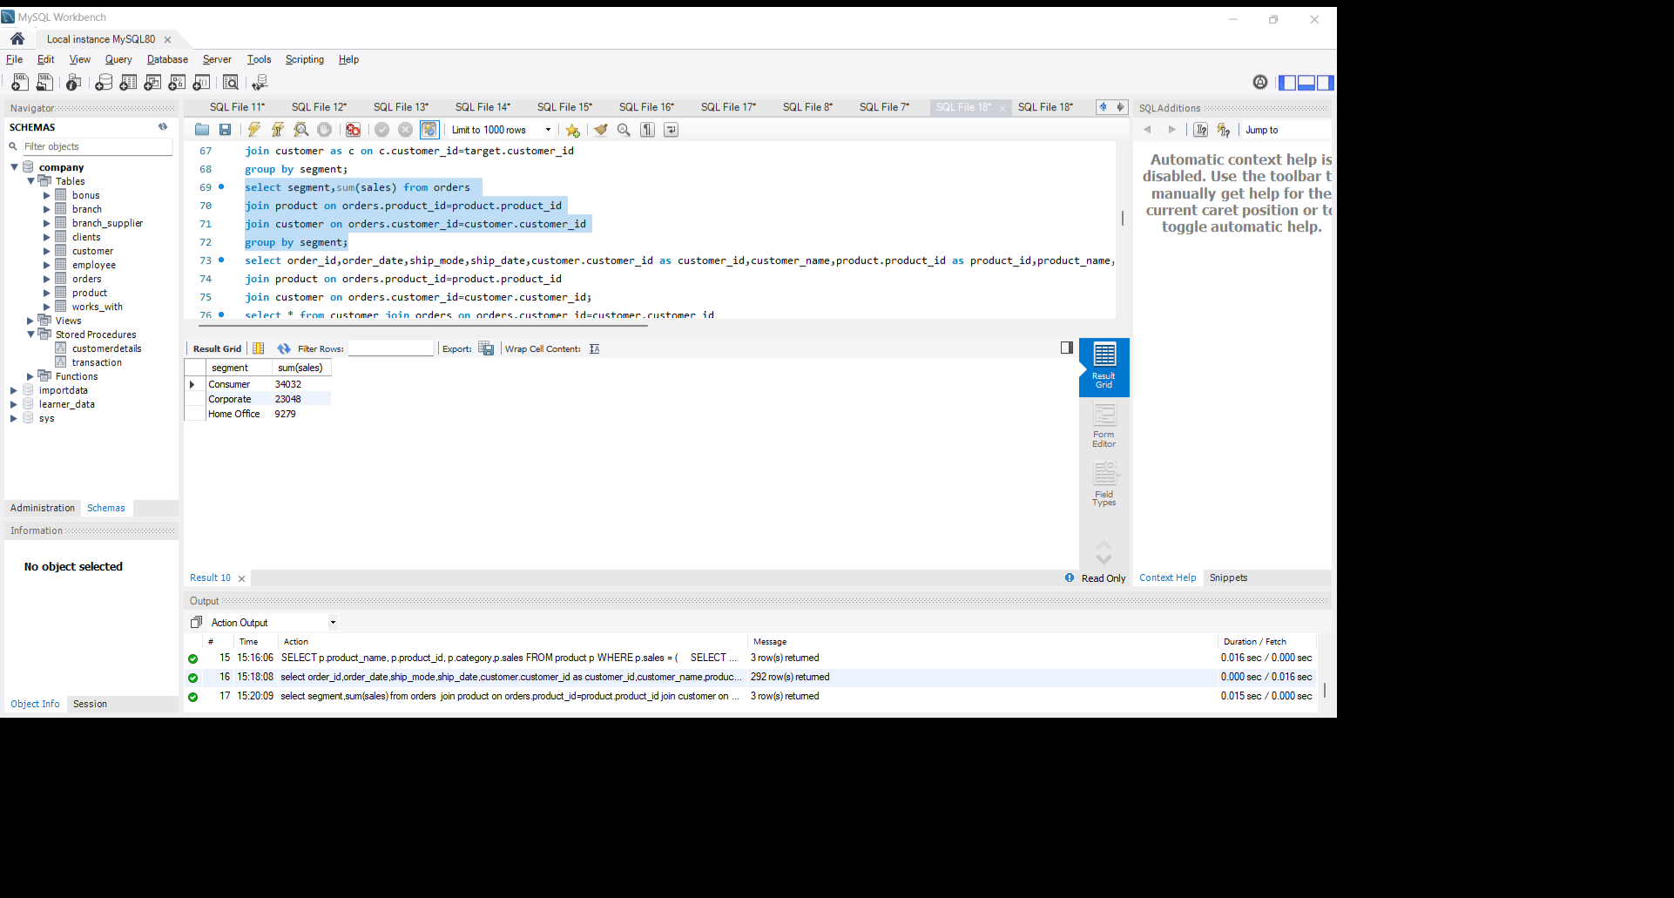
Get the total sales revenue along with the customer segment.? select segment,sum(sales) from orders join product on orders.product_id=product.product_id join customer on orders.customer_id=customer.customer_id group by segment;
Result:

Slide 28
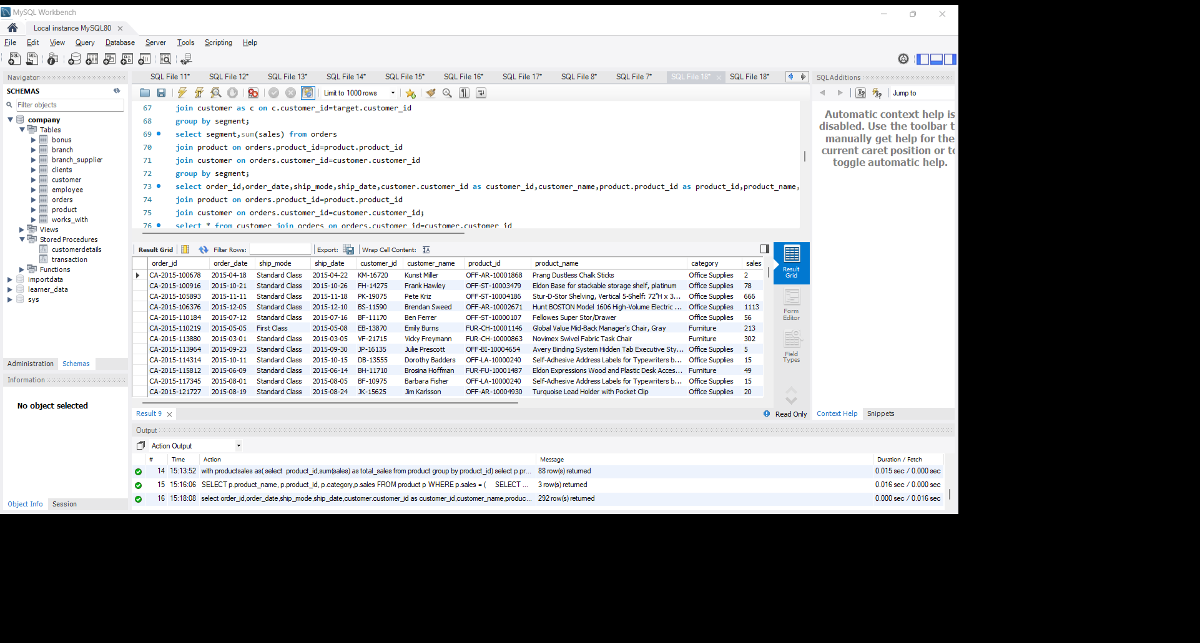
Combine customer, order, and product information in a single query.?
select order_id,order_date,ship_mode,ship_date,customer.customer_id as customer_id,customer_name,product.product_id as product_id,product_name,category,sales,sub_category,customer_name,segment,country,city,state,region,postal_code from orders
join product on orders.product_id=product.product_id
join customer on orders.customer_id=customer.customer_id;
Result:

Slide 29
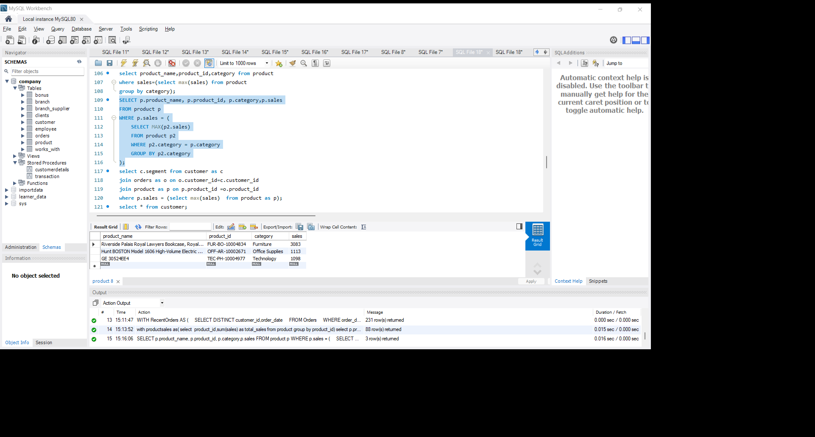
Retrieve products belonging to categories with the highest sales.?
SELECT p.product_name, p.product_id, p.category,p.sales
FROM product p
WHERE p.sales = (
SELECT MAX(p2.sales)
FROM product p2
WHERE p2.category = p.category
GROUP BY p2.category
);
Result:

Slide 30
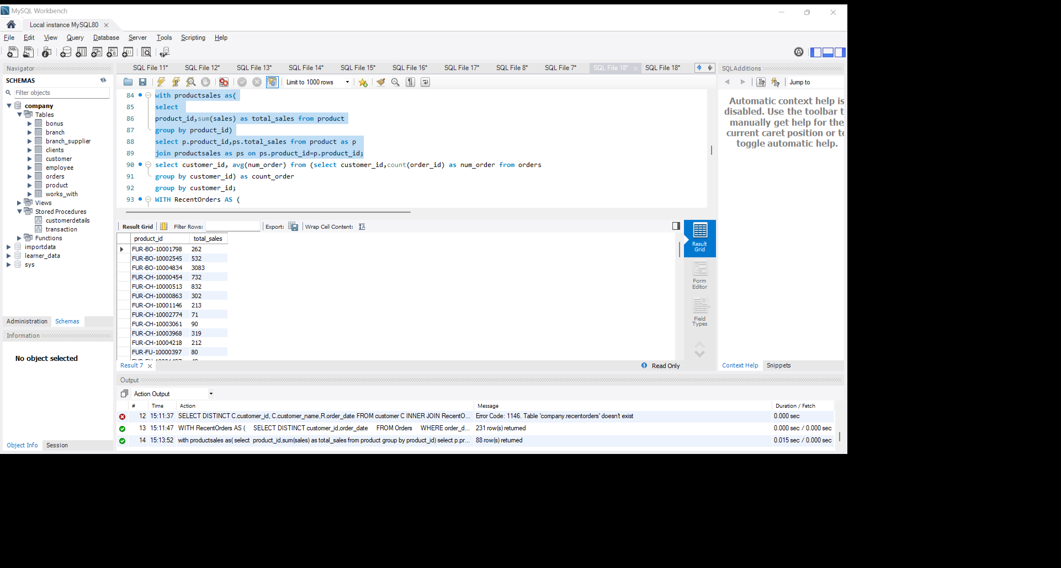
Create a CTE to calculate the total sales revenue for each product.?
with productsales as(
select
product_id,sum(sales) as total_sales from product
group by product_id)
select p.product_id,ps.total_sales from product as p
join productsales as ps on ps.product_id=p.product_id;
Result:

Slide 31
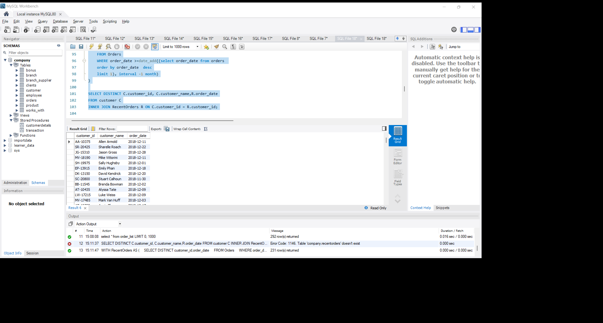
Use a CTE to find customers who have placed orders in the last month.?
WITH RecentOrders AS (
SELECT DISTINCT customer_id,order_date
FROM Orders
WHERE order_date >=date_add((select order_date from orders
order by order_date desc
limit 1), interval -1 month)
)
SELECT DISTINCT C.customer_id, C.customer_name,R.order_date
FROM customer C
INNER JOIN RecentOrders R ON C.customer_id = R.customer_id;
Result:

Slide 32
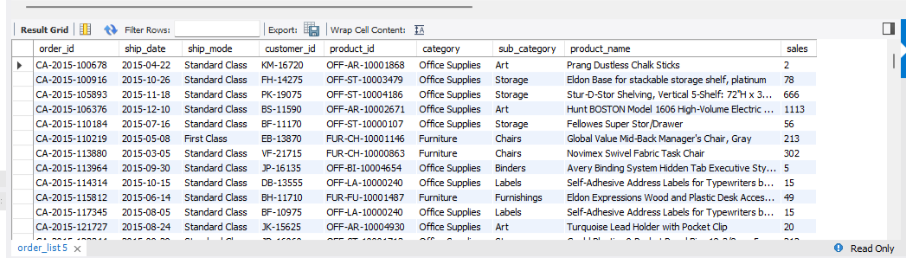
Generate a view to list all orders with their corresponding product information.?
create view order_list as
select order_id,ship_date,ship_mode,customer_id,product.product_id,category,sub_category,product_name,sales from orders
join product on product.product_id=orders.product_id;
select * from order_list;
Result:

Slide 33
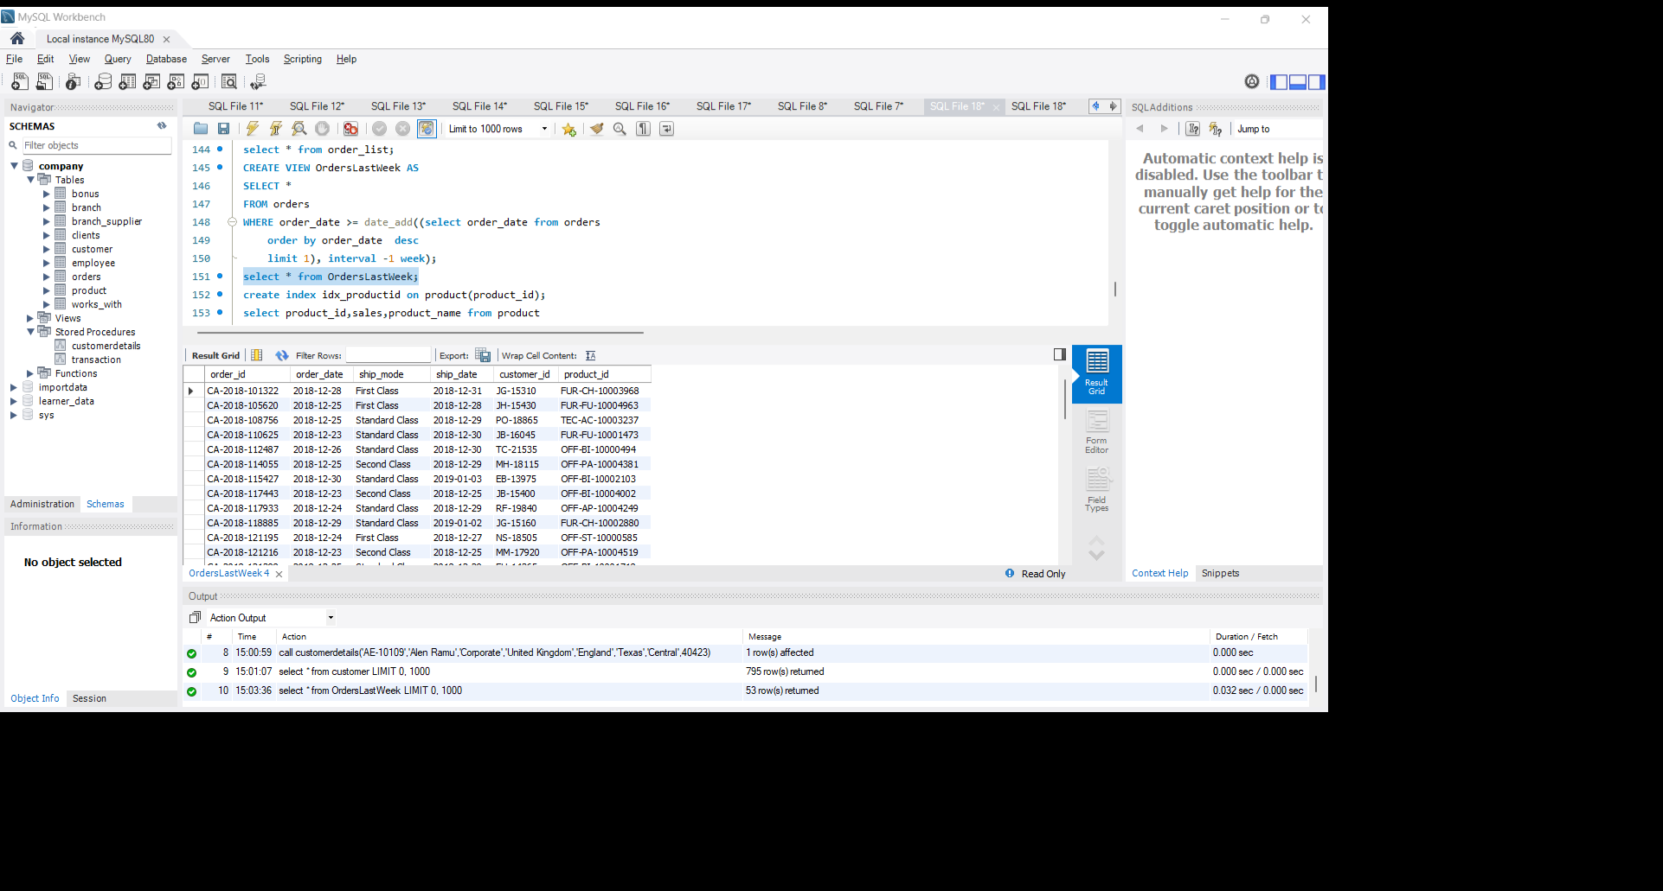
Generate a view to list orders placed in the last week.?
CREATE VIEW OrdersLastWeek AS
SELECT *
FROM orders
WHERE order_date >= date_add((select order_date from orders
order by order_date desc
limit 1), interval -1 week);
select * from OrdersLastWeek;
Result:

Slide 34
Implement a stored procedure to insert new orders into the database.?
delimiter //
create procedure customerdetails(
IN customerid varchar(20),
IN customername varchar(30),
IN segment varchar(20),
IN country varchar(20),
IN city varchar(20),
IN state varchar(20),
IN region varchar(10),
IN postal_code int )
Begin
insert into customer values(customerid,customername,segment,country,city,state,region,postal_code);
end
//
delimiter ;
call customerdetails('AE-10189','Alen Ramu','Corporate','United Kingdom','England','Texas','Central',40423);
select * from customer;

Slide 35
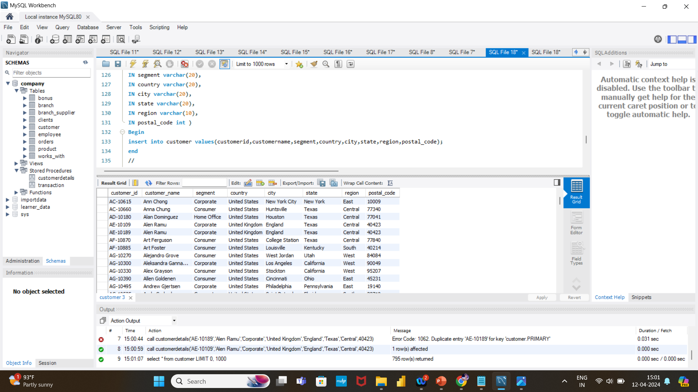
Result:

Slide 36
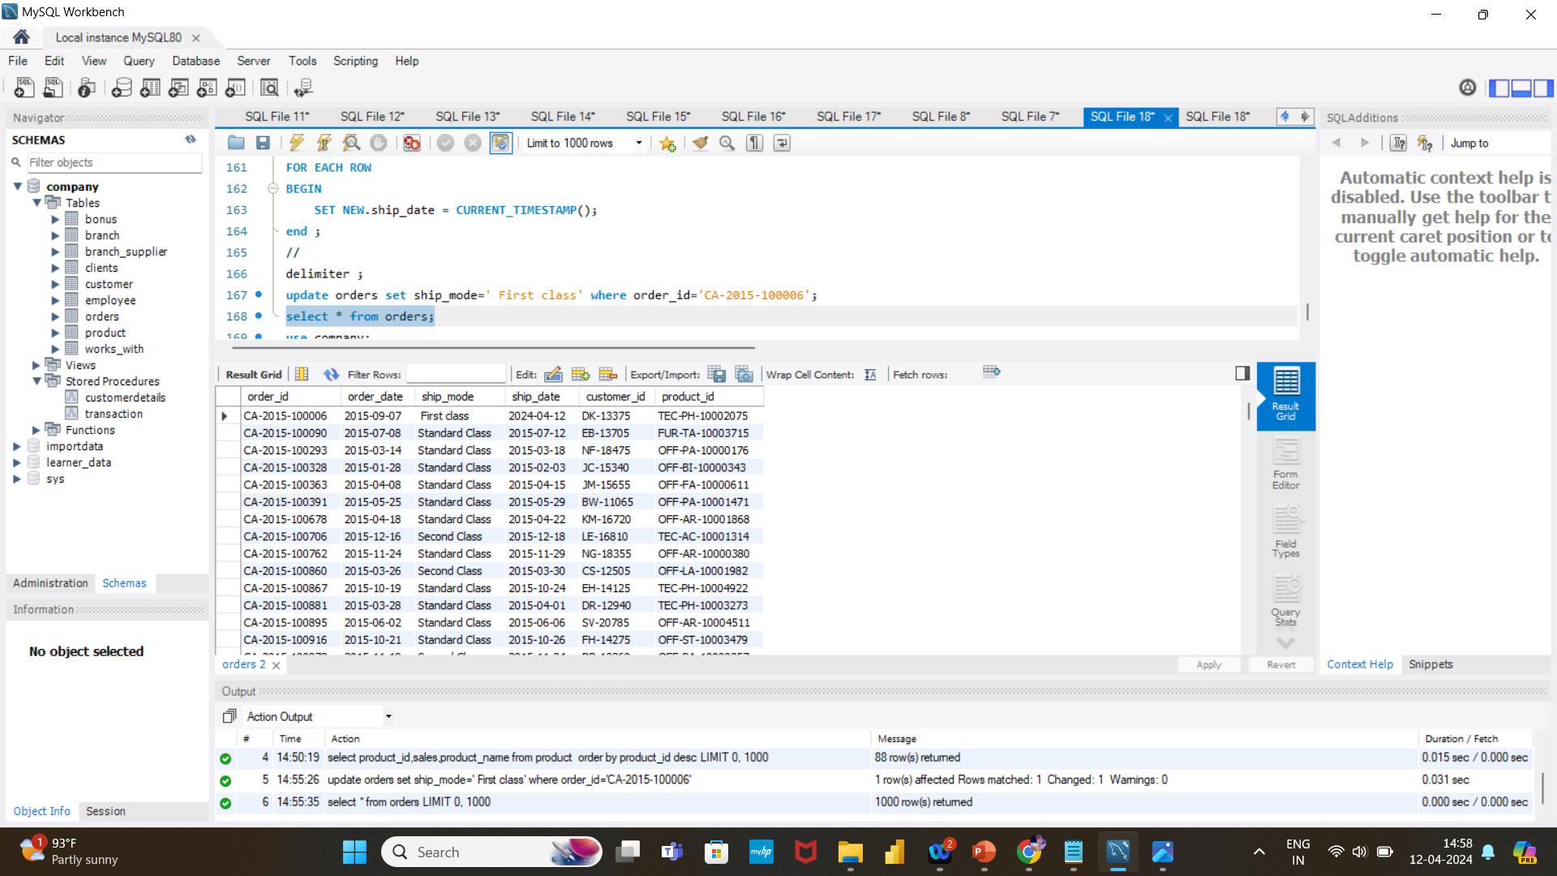
Implement a trigger to update the ship_date when an order is updated.
delimiter //
CREATE TRIGGER UpdateShipDate
Before UPDATE ON Orders
FOR EACH ROW
BEGIN
SET NEW.ship_date = CURRENT_TIMESTAMP();
end ;
//
delimiter ;
update orders set ship_mode=' First class' where order_id='CA-2015-100006';
select * from orders;
Result:

Slide 37
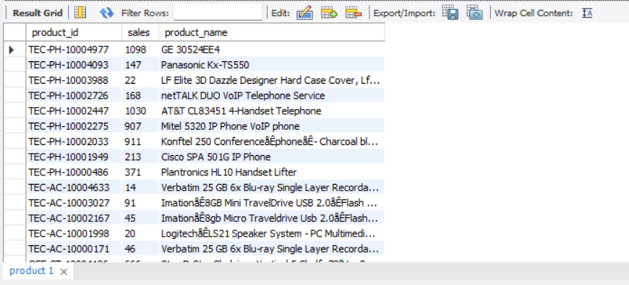
Implement indexes on columns frequently used in search conditions, such as product_id?
create index idx_productid on product(product_id);
select product_id,sales,product_name from product
order by product_id desc;
Result:

